Slide 1
Leadership and Social Influence Processes

Slide 2
Leadership and Social Influence Processes
Status and Power
Leadership
Followership
Contingency Theory
Group Norms: Social Influence and Conformity
Group Development
Review of the Systems Approach

Slide 3
Status and Power
Types of Status
  Status is defined as a person’s position or rank relative to others in a group.
  Differences in status of members of a group may either facilitate or hinder other members from interacting in any type of groups.

Slide 4
Status and Power
Types of Status
  Some have theorized that power and status are a function of the ratio of the number of successful power acts to the number of attempts to influence.
  The success rate and relative status of any individual will vary from group to group.

Slide 5
Status and Power
Types of Power
  Reward power
  Coercive power
  Legitimate power
  Referent power
  Expert power

Slide 6
Status and Power
Power tends to equate to effectiveness in the eyes of others.
  Comments in small groups tend to be directed more often (by direction of eye contact) to higher-status group members than to those of lower status.
Positive and Negative Uses of Power
  Most experts agree that power tactics are amoral.

Slide 7
Leadership
An effective leader is essential for optimal group performance.
Historic Trends
  Trait Theory
    The physical traits associated with leadership were height, weight, physical attractiveness, and body shape.
  Circumstances Theory
    A person may be an effective leader in one circumstance but perform poorly in a different circumstance.

Slide 8
Leadership
Historic Trends
  Function Theory
    Leadership consists of certain behaviors, or functions, that groups must have performed.
      1. Task orientation
      2. People orientation
      3. Change-oriented behaviors (Yukl et al, 2002)

Slide 9
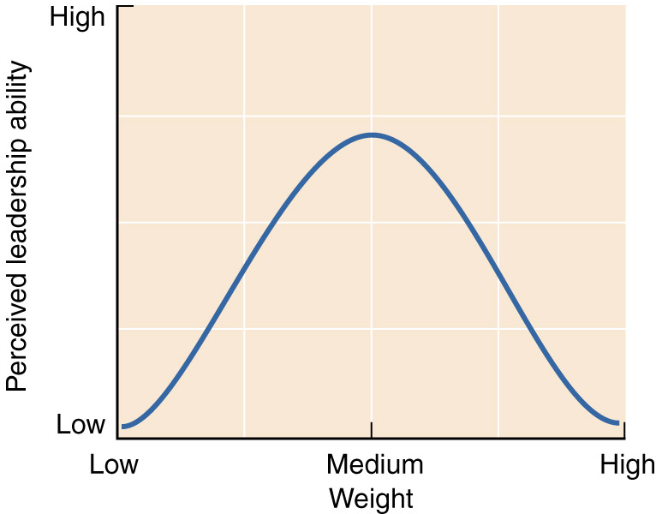
Leadership
  Hypothetical Relationship Between Weight and Leadership
Source: Copyright © 1971 by Henry R. Martin. Reprinted with
permission of Meredith Corporation and Henry Martin.

Slide 10
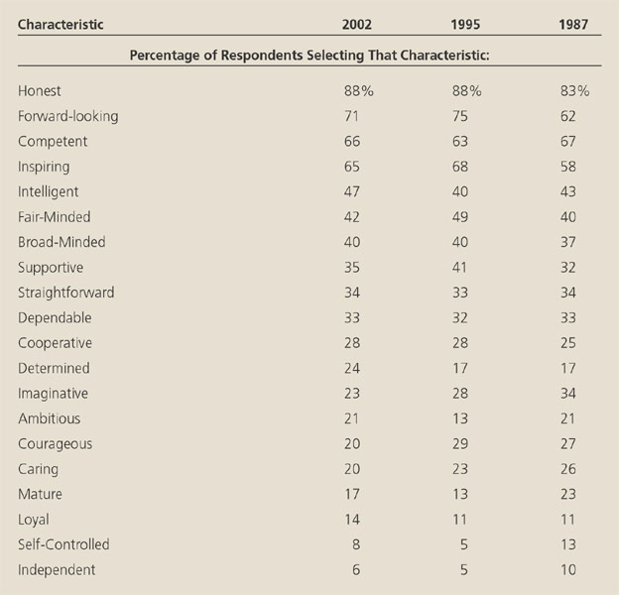
Leadership
  Leadership Characteristics Appearing in Three Studies
Source: Reprinted with permission of Jossey-Bass, from James Kouzes and
Barry Posner. The Leadership Challenge, copyright © 2002 by Jossey-Bass.

Slide 11
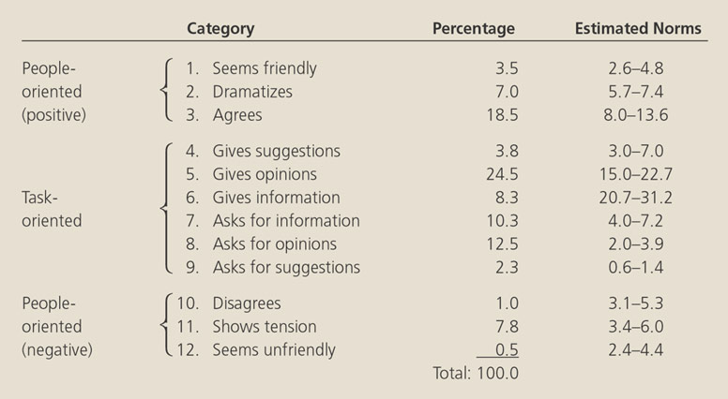
Leadership
Source: Adapted from Robert F. Bates. Personality and Interpersonal Behavior. Copyright © 1970 by Holt, Rinehart & Winston, Inc. Reprinted by permission of Holt, Rinehart & Winston, Inc.
Reprinted by permission of Holt, Rinehart & Winston, Inc.

Slide 12
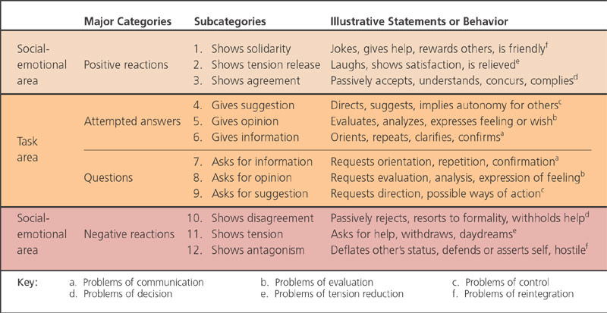
Leadership
  Interaction Process Analysis. Categories of Communicative Acts
Source: Based on Robert F. Bates. Interaction Process Analysis (Reading, Mass.: Addison-Wesley, 1950), p. 9;
A. Paul Hare. Handbook of Small Group Research (New York: Free Press of Glencoe, 1962), p. 66; and
Clovis R. Shepherd. Small Groups, Some Sociological Perspectives (San Francisco: Chandler, 1964), p. 30.

Slide 13
Leadership
Leadership Styles
  Early studies identified three different styles:
    Autocratic
    Democratic
    Laissez-faire

Slide 14
Leadership
SuperLeaders
  A SuperLeader who gets a lot of other people involved is said to develop SuperTeams.
  Manz and Neck (1999) have proposed the idea of self-leadership:
    We are each responsible for our own choices.
    The challenge is to channel these choices in a desirable direction.

Slide 15
Followership
Followership Styles
  Dependent
  Counterdependent
  Independent

Slide 16
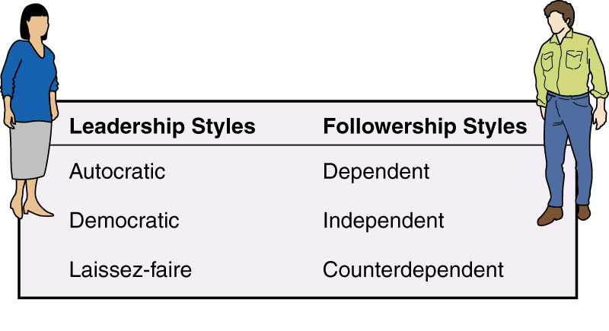
Followership
Leadership and Followership Styles

Slide 17
Followership
Research has revealed that followers contribute 80% to the success of the organization, while the leader only contributes a mere 20%.
Followers should be valued and held accountable for the successes of any group while their leaders should be rewarded for encouraging the followers to reach their full potential.

Slide 18
Contingency Theory
Fiedler and Chemers (1974) and Potter and Fiedler (1993) argue that a combination of three separate factors determines a leader’s effectiveness:
  Leader-member relations
  Task structure
  Position power

Slide 19
Contingency Theory
Fielder’s four primary tests to measure a leader’s personality and how it will apply to different situations:
  Least Preferred Coworkers Scale
  Situational Favorableness
  Leader-Situation Match and Mismatch
  TBA

Slide 20
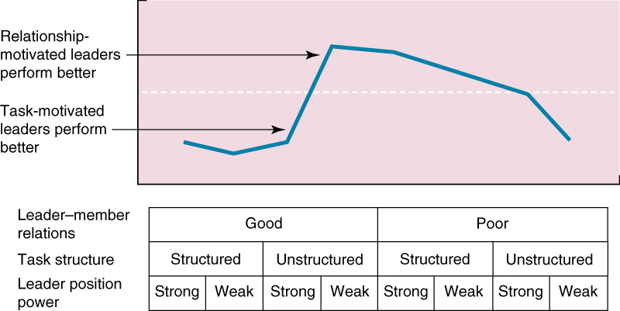
Contingency Theory
Fiedler’s Contingency Leadership Model
Source: From Fiedler and Chemers. Leadership and Effective Management (Glenview, Ill: Scott, Foresman, 1974), p. 80. Copyright © 1974 by Scott, Foresman & Co. Reprinted by permission of the author.

Slide 21
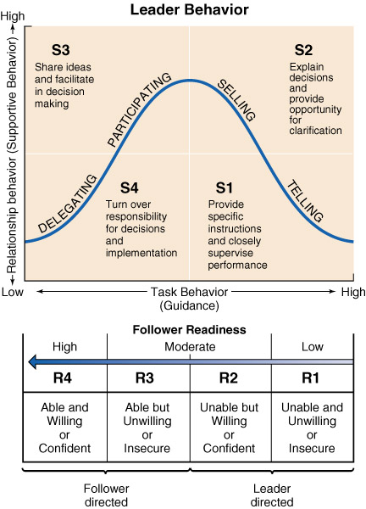
Contingency Theory
Hershey and Blanchard’s Contingency Model of Leadership
Source: From Hershey, Blanchard, and Johnson, Management of Organizational Behavior, 8th ed. (Englewood Cliffs, N.J.:Prentice-Hall, 2001), p. 182.

Slide 22
Group Norms: Social Influence and Conformity
Wood, Phillips, and Pedersen (1986) define norms as “standardized patterns of belief, attitude, communication and behavior within groups.”

Slide 23
Group Norms: Social Influence and Conformity
The following guidelines help groups arrive at more creative solutions about 75 percent of the time (Leonard and Swaps, 1999).
  Avoid changing your mind only to avoid conflict and to reach agreement and harmony.
  Withstand pressures to yield, which have on objective or logically sound foundation.
  View differences of opinion as both natural and helpful.

Slide 24
Group Norms: Social Influence and Conformity
Conformity: Research and Applications
  Conformity is when most members of the group agree on a particular outcome and minority influence is when the decision made reflects the opinion of the minority.
  In group situations, the social influence of the majority often causes the opposing minority members to change their views to that of the majority, even if the majority is clearly wrong.

Slide 25
Group Norms: Social Influence and Conformity
Conformity: Research and Applications
  Groupthink represents a form of social influence of the majority that results in a dangerous level of agreement by all members of the group, even if the decided action is obviously wrong.
  To prevent Groupthink, alternative viewpoints should be fostered by the leader instead of hidden.

Slide 26
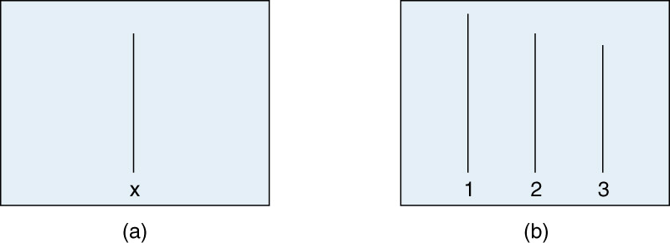
Group Norms: Social Influence and Conformity

Slide 27
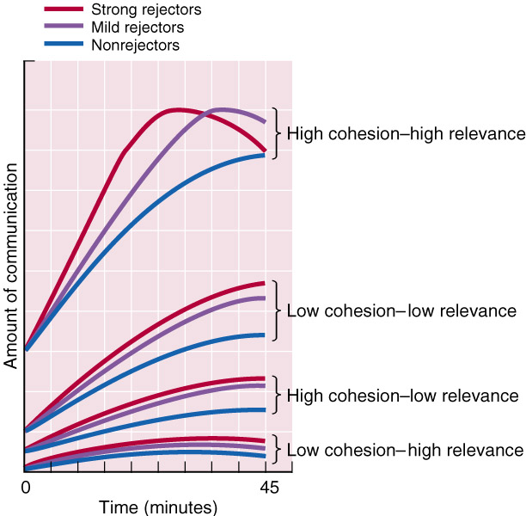
Group Norms: Social Influence and
Conformity
  Theoretical Curves of Communications from Strong Rejectors, Mild Rejectors, and Four Nonrejectors to the Deviant in the Four Experimental Conditions.
Source: From Schacter. “Deviation, rejection, and communication.” Journal of Abnormal and Social Psychology 46:202. American Psychological Association, copyright © 1951.

Slide 28
Group Development
Group development seems to be partly the result of individual psychological needs and partly the result of the social influences manifested in the group.
  Phase 1 (orientation)
    Seems to be a period in which group members simply try to break the ice and begin to find out enough about one another to have some common basis for functioning.
  Phase 2 (conflict)
    Frequently characterized by conflict of one kind or another.

Slide 29
Group Development
Group development . . . (continued)
  Phase 3 (emergence)
    Involves a resolution of the conflict experienced in Phase 2.
  Phase 4 (reinforcement)
    The phase of maximum productivity and consensus.

Slide 30
Review of the Systems Approach
High-status individuals tend to have more power.
The leadership style that would be appropriate in one situation with one set of followers may not be the most appropriate in a different situation with a different set of followers.

Slide 31
The Systems Approach
Conformity pressure differs depending on the type of group, the personalities of the group members, and a number of other factors.
Groups go through fairly common phases, depending on the type of group.

